Slide 1
AI Pipeline for Image Segmentation and Object Analysis
Monalisa Burma
06/08/2024

Slide 2
Introduction
The aim of this project was to develop an advanced AI pipeline capable of performing comprehensive image analysis by segmenting, identifying, and extracting detailed information from objects within an image.
The pipeline processes an input image to identify individual objects, extract relevant data, and generate meaningful summaries.
The final output integrates these insights into a visually annotated image and a detailed summary table, providing a powerful tool for understanding and interpreting complex image content.

Slide 3
Approach Overview
Key Steps:
Image Segmentation
Object Extraction & Storage
Object Identification
Text/Data Extraction (OCR)
Summarization and Data Mapping
Output Generation

Slide 4
Implementation Highlights
Segmentation: Implemented segmentation using a pre-trained model. Successfully segmented objects within the image and visualized the results.
Extraction & Storage: Stored segmented objects with metadata.
Object Identification: Used an image captioning model to generate descriptions for each object. Successfully identified and described each object.
Text/Data Extraction from Objects : Extracted text from object images using OCR. Summarization: Created summaries of object attributes.
Summarize Object Attributes: Generated summaries for each object’s attributes. Created concise summaries that captured key information.
Data Mapping : Mapped descriptions, text, and summaries to each object in a structured format. Data mapping was successfully completed and saved as a CSV/JSON file.
Final Output: Produced a final annotated image and summary table. The output clearly visualized the results of the pipeline.

Slide 5
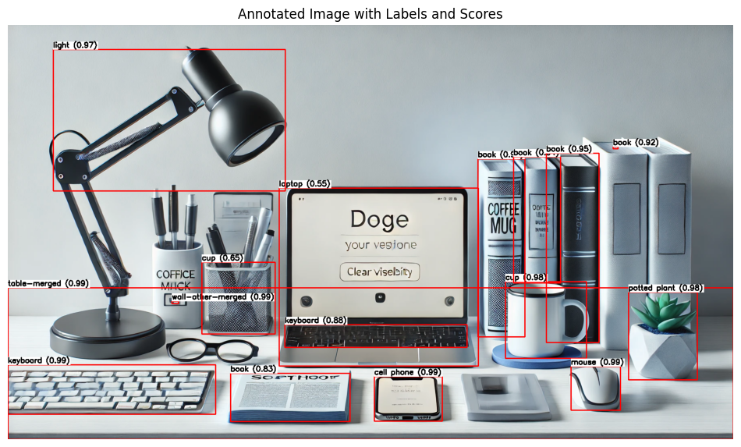
Segmented Image

Slide 6
Challenges and Results
Model Performance: Fine-tuning models for accuracy.
Data Mapping Complexity: Ensuring accurate data mapping.
Resource Limitations: High computational resources required.
Text Extraction Accuracy: OCR struggled with certain text types.
Output Visualization: Ensuring clear and effective layout.

Slide 7
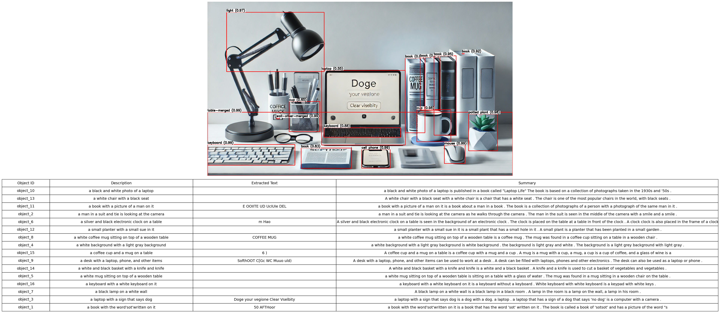
Final Output Image

Slide 8
Results and Conclusion
Successfully created a comprehensive pipeline that provides detailed insights and visualizations of image content.
This project demonstrates the effectiveness of combining AI methodologies for image analysis. Future work could focus on further refinement and extension of the pipeline for more complex applications.

